Slide 1
ESHAN COLLEGE OF ENGINEERING MATHURA
ER. SHAILESH KUMAR
ASST. PROFESSOR
DEPARTMENT OF CIVIL ENGINEERING

Slide 2
Rigid Body Equilibrium -A rigid body will remain in equilibrium provided
• sum of all the external forces acting on the body is equal to zero, and
• Sum of the moments of the external forces about a point is equal to zero

Slide 3
Division of Mechanics
Mechanics of fluids, a phase of it is called hydraulics
Mechanics of materials, more often called strength of materials, as subject which deals with the internal forces or stresses in bodies
Analytic mechanics or mechanics of engineering, a study of external forces on bodies, ordinarily rigid bodies or bodies considered to be rigid, and of the effects of these forces on the motions of bodies.

Slide 4
Analytic Mechanics
Analytic mechanics includes the study of:
Statics, which deals with the forces acting on bodies or structures which are at rest relative to the earth or which are moving with a constant velocity
Dynamics, which deals with the accelerated motion of bodies.

Slide 5
Our Concern: Statics
We can consider statics as a special case of dynamics, in which the acceleration is zero.
However, statics deserves separate treatment in engineering education since many objects are designed with the intention that they remain in equilibrium.

Slide 6
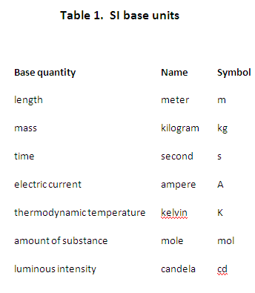

Slide 7
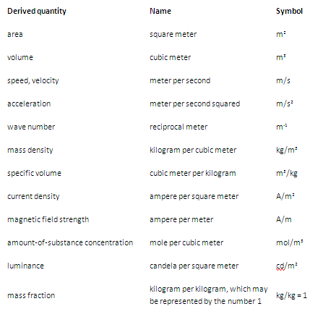
Table 2. Examples of SI derived units

Slide 8
For ease of understanding and convenience, SI derived units have been given special names and symbols, as shown in Table 3.

Slide 9
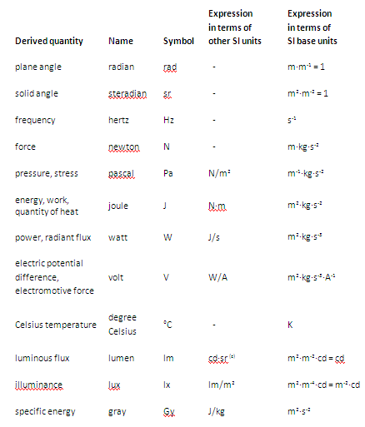
Table 3. SI derived units with special names and symbols

Slide 10
Analytic Mechanics: Deals with Forces
In mechanics, a force arises out of the interaction of two bodies and causes or tends to cause the motion of the bodies. A body which is at rest or is moving with a constant velocity is said to be in equilibrium.
Force is a vector quantity. The characteristics of a force vector are that it has (1) magnitude (2) sense or direction and (3) line of action.

Slide 11
Vector Addition & Subtraction
Vector quantities, such as force, acceleration, velocity and momentum, cannot be added or subtracted as are scalar quantities, which posses magnitude only

Slide 12
THANK YOU

