Slide 1
ESHAN COLLEGE OF ENGG FARAH MATHUTRA
NAME – ANUJ VERMA
ASST.PROFESSOR
SUBJECT NAME –IRRIGATION ENGG

Slide 14
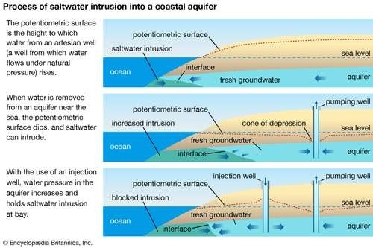

Slide 15
