Slide 1
CPU Scheduling
ESHAN COLLEGE OF ENGINEERING, MATHURA

Slide 2
ESHAN COLLEGE OF ENGINEERING, MATHURA
Basic Concepts
Maximum CPU utilization obtained with multiprogramming
CPU–I/O Burst Cycle – Process execution consists of a cycle of CPU execution and I/O wait
CPU burst distribution

Slide 3
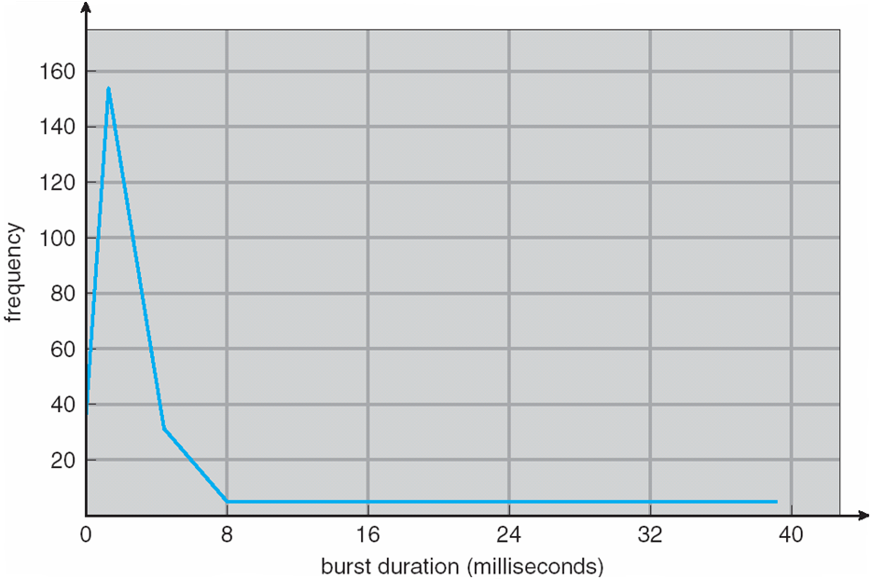
ESHAN COLLEGE OF ENGINEERING, MATHURA
Histogram of CPU-burst Times

Slide 4
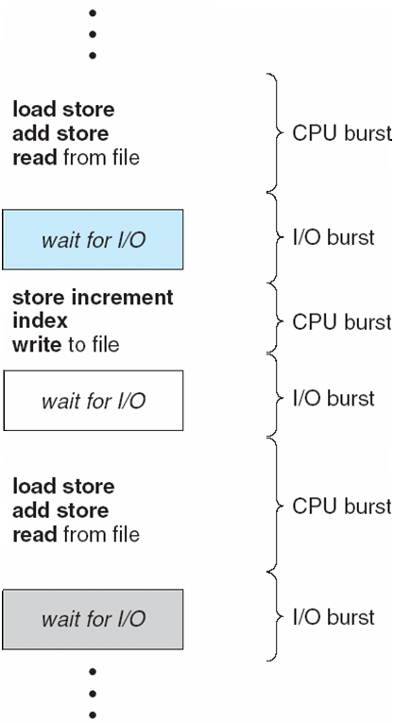
ESHAN COLLEGE OF ENGINEERING, MATHURA
Alternating Sequence of CPU and I/O Bursts

Slide 5
ESHAN COLLEGE OF ENGINEERING, MATHURA
CPU Scheduler
Selects from among the processes in memory that are ready to execute, and allocates the CPU to one of them.
CPU scheduling decisions may take place when a process:
1. Switches from running to waiting state
2. Switches from running to ready state
3. Switches from waiting to ready
Terminates
Scheduling under 1 and 4 is non-preemptive
All other scheduling is preemptive – implications for data sharing between threads/processes

Slide 6
ESHAN COLLEGE OF ENGINEERING, MATHURA
Dispatcher
Dispatcher module gives control of the CPU to the process selected by the scheduler; this involves:
switching context
switching to user mode
jumping to the proper location in the user program to restart that program
Dispatch latency – time it takes for the dispatcher to stop one process and start another running

Slide 7
ESHAN COLLEGE OF ENGINEERING, MATHURA
Scheduling Criteria
CPU utilization – keep the CPU as busy as possible
Throughput – # of processes that complete their execution per time unit
Turnaround time – amount of time to execute a particular process
Waiting time – amount of time a process has been waiting in the ready queue
Response time – amount of time it takes from when a request was submitted until the first response is produced, not output (for time-sharing environment)

Slide 8
ESHAN COLLEGE OF ENGINEERING, MATHURA
Scheduling Algorithm Optimization Criteria
Max CPU utilization
Max throughput
Min turnaround time
Min waiting time
Min response time

Slide 9
ESHAN COLLEGE OF ENGINEERING, MATHURA
First-Come, First-Served (FCFS) Scheduling
Process Burst Time
P₁ 24
P₂ 3
P₃ 3
Suppose that the processes arrive in the order: P₁ , P₂ , P₃ The Gantt Chart for the schedule is:
Waiting time for P₁ = 0; P₂ = 24; P₃ = 27
Average waiting time: (0 + 24 + 27)/3 = 17
P₁
P₂
P₃
0
24
27
30

Slide 10
ESHAN COLLEGE OF ENGINEERING, MATHURA
FCFS Scheduling (Cont.)
Suppose that the processes arrive in the order:
P₂ , P₃ , P₁
The Gantt chart for the schedule is:
Waiting time for P₁ = 6; P₂ = 0; P₃ = 3
Average waiting time: (6 + 0 + 3)/3 = 3
Much better than previous case
P₂
P₃
P₁
0
3
6
30

Slide 11
ESHAN COLLEGE OF ENGINEERING, MATHURA
Shortest-Job-First (SJF) Scheduling
Associate with each process the length of its next CPU burst. Use these lengths to schedule the process with the shortest time.
SJF is optimal – gives minimum average waiting time for a given set of processes.
The difficulty is knowing the length of the next CPU request.

Slide 12
ESHAN COLLEGE OF ENGINEERING, MATHURA
Example of SJF
Process Burst Time
P₁ 6
P₂ 8
P₃ 7
P₄ 3
SJF Gantt chart
Average waiting time = (3 + 16 + 9 + 0) / 4 = 7
P₄
P₁
P₃
P₂
0
3
9
16
24

Slide 13
ESHAN COLLEGE OF ENGINEERING, MATHURA
Priority Scheduling
A priority number (integer) is associated with each process
The CPU is allocated to the process with the highest priority (smallest integer ≡ highest priority)
Preemptive
Non-preemptive
Note that SJF is a priority scheduling where priority is the predicted next CPU burst time
Problem ≡ Starvation – low priority processes may never execute
Solution ≡ Aging – as time progresses increase the priority of the process

Slide 14
ESHAN COLLEGE OF ENGINEERING, MATHURA
Round Robin (RR)
Each process gets a small unit of CPU time (time quantum), usually 10-100 milliseconds. After this time has elapsed, the process is preempted and added to the end of the ready queue.
We can predict wait time: If there are n processes in the ready queue and the time quantum is q, then each process gets 1/n of the CPU time in chunks of at most q time units at once. No process waits more than (n-1)q time units.
Performance
q large ⇒ FIFO
q small ⇒ may hit the context switch wall: q must be large with respect to context switch, otherwise overhead is too high

Slide 15
ESHAN COLLEGE OF ENGINEERING, MATHURA
Example of RR with Time Quantum = 4
Process Burst Time
P₁ 24
P₂ 3
P₃ 3
The Gantt chart is:
Typically, higher average turnaround than SJF, but better response.
P₁
P₂
P₃
P₁
P₁
P₁
P₁
P₁
0
4
7
10
14
18
22
26
30

Slide 16
ESHAN COLLEGE OF ENGINEERING, MATHURA

Slide 17
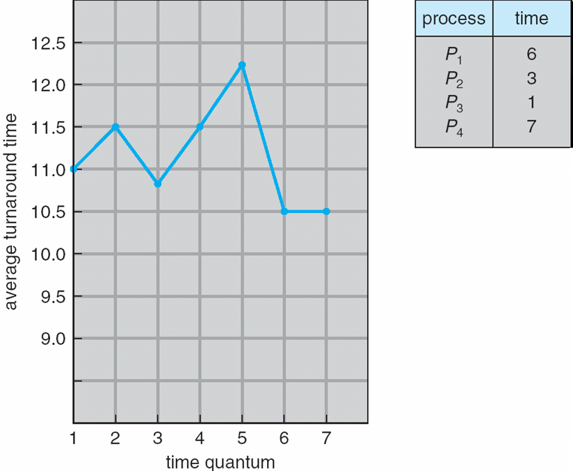
ESHAN COLLEGE OF ENGINEERING, MATHURA
Turnaround Time Varies With The Time Quantum

