Slide 1
Eshan College of Engineering
Department of Mechanical Engineering
AUTOCAD Basic-III
Presented by
Mr. Rajan Khare
Assistant Professor

Slide 2
Colours + Line Weights

Slide 3
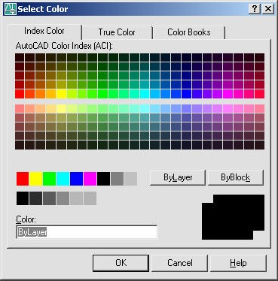
AutoCAD 2D Tutorial Color Command 12.6
1. Choose
Format, Color.
or
DDCOLOR at the command prompt. Command: DDCOLOR or COL
2. Type
or
Color on the Object Properties toolbar and then select a color from the list or select Other to display the Select Color dialog box.
3. Choose
TIP:
These settings ignore the current layer settings for color.
By Layer
If you enter bylayer, new objects assume the color of the layer upon which they are drawn.
By Block
If you enter byblock, AutoCAD draws new objects in the default color (white or black, depending on your configuration) until they are grouped into a block. When the block is inserted in the drawing, the objects in the block inherit the current setting of the COLOR command.

Slide 4
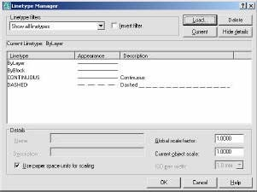
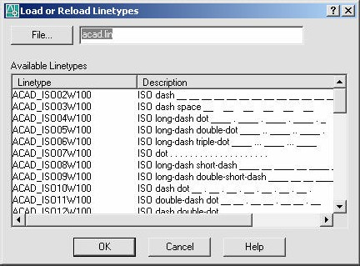
AutoCAD 2D Tutorial Linetypes 12.7
Loading and Changing Linetypes
1. Choose
Format, Linetype...
or
DDLTYPE at the command prompt. Command:DDLTYPE or LT
2. Type
3. Choose
Load... to see a list of available linetypes.
4. Choose
the desired linetype to assign.
5. Click
OK.

Slide 5
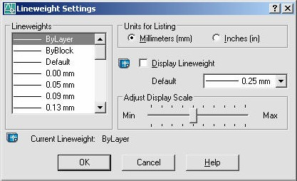
AutoCAD 2D Tutorial Lineweights 12.8
Loading and Changing Lineweights
1. Choose
Format, Lineweight...
or
LINEWEIGHT at the command prompt. Command: LINEWEIGHT or LWEIGHT
2. Type
or
a lineweight to make current from the Object Properties menu.
4. Pick
TIPS:
Lineweights can also be assigned to layers.
The Display Lineweights feature can be turned on/off o n the status bar to show or not show lineweights in the drawing, thus making regenerations faster.
Lineweights are displayed using a pixel width in proportion to the real- world unit value at which they plot. If you are using a high-resolution monitor, you can adjust the lineweight display scale to better display different lineweight widths.

Slide 6
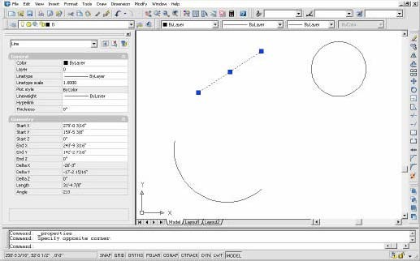
AutoCAD 2D Tutorial
Object Properties 12.9
Choose
Click
Modify, Properties.
or
the Properties icon.
or
DDCHPROP or DDMODIFY at the command prompt. Command: DDCHPROP (CH) or
DDMODIFY (MO)
Objects whose properties you want to change Pick a window for DDCHPROP, single object for DDMODIFY.
Select objects:(select) ENTER to accept objects. Select objects: (press enter)
One of the following properties to change.
3.
Type
4.
Pick
5.
Press
6.
Choose

Slide 7
Other Useful Functions

Slide 8
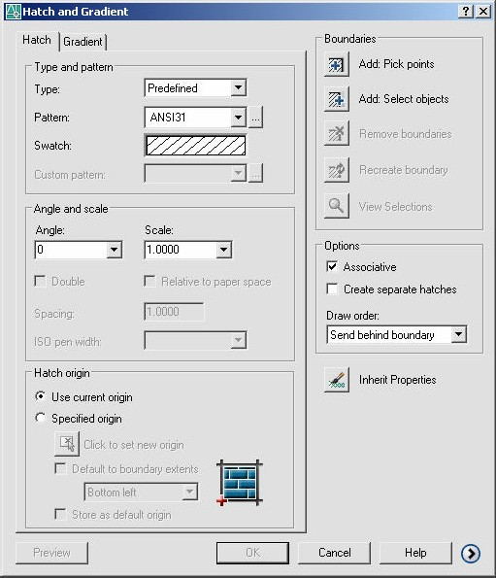
AutoCAD 2D Tutorial
BHATCH Command 17.1
1. Choose
Draw, Hatch...
or
the Hatchicon.
or
BHATCH at the command prompt Command: BHATCH
2.
Click
3.
Type
- 152 -

Slide 9
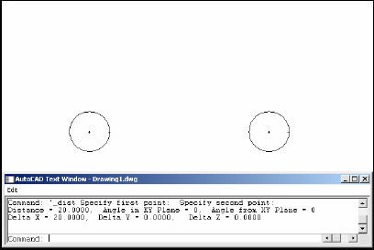
AutoCAD 2D Tutorial Measuring Distances 8.2
1. Choose
Tools, Inquiry, Distance.
or
the Distance icon from the Inquiry Toolbar.
or
DIST at the command prompt Command: DIST
The first point to measure from First point: pick point
The second point to measure to Second point: pick point
2. Click
3. Type
4. Pick
5. Pick
Distance Between Circle Centers
TIP:
Be sure to use Object Snaps with the MEASURE command.
- 55 -

Slide 10
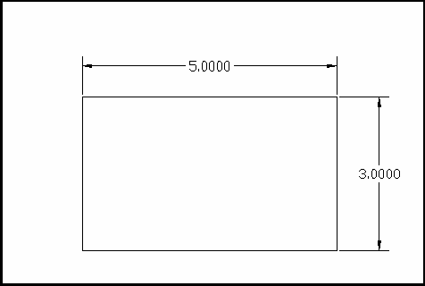
AutoCAD 2D Tutorial
Linear Dimensions 26.1
1 . Choose
Dimension, Linear.
or
the Linear Dimension command from the toolbar.
2 . Click
or
DIM at the command prompt. Command: DIM
Dim: HOR or VER
3 . Type
- 223 -

Slide 11
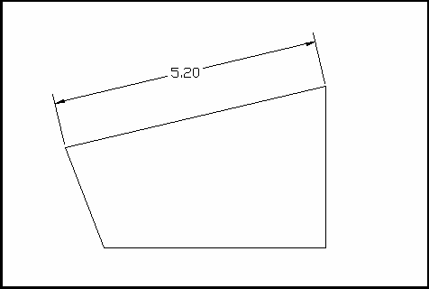
AutoCAD 2D Tutorial
Aligned Dimensions 26.2
1 . Choose
Dimension, Aligned.
or
the Aligned Dimension command from the toolbar.
2 . Click
or
DIM at the command prompt. Command: DIM
Dim: ALIGNED
3 . Type
- 224 -

Slide 12
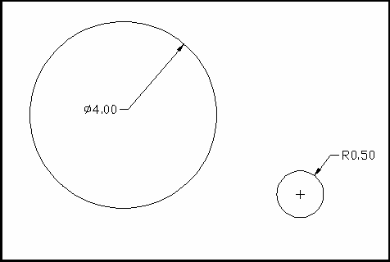
AutoCAD 2D Tutorial
Radial Dimensions 26.3
1 . Choose
Dimension, Radius or Diameter.
or
the Radial Dimensions command from the toolbar.
2 . Click
or
DIM at the command prompt. Command: DIM
Dim: RADIUS or DIAMETER
3 . Type
- 225 -

Slide 13
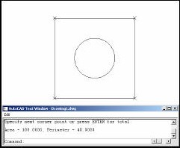
AutoCAD 2D Tutorial Calculating Areas 8.3
1. Choose
Tools, Inquiry, Area.
or
the Area icon.
or
AREA at the command prompt Command: AREA
The first point for area calculation
<First point>/Object/Add/Subtract: pick
Next point: pick
Next point: pick
ENTER when you are finished choosing points. Area of Rectangle
2. Click
3. Type
4. Pick
Pick
Pick
Press
Object
Allows user to pick an object to calculate area (circle or polyline).
Adds separate areas for a total area calculation Subtracts areas from each other.
Add Subtract
TIPS:
Be sure to use Object Snaps with the MEASURE command
To subtract an area, you must first be in “add” mode to add the first area.
- 56 -

Slide 14
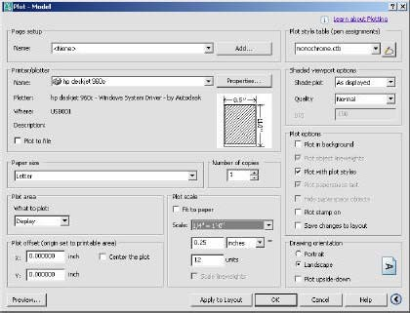
AutoCAD 2D Tutorial
Plot Settings
Choose
Choose
the Plot Settings tab.
the appropriate paper size based on the chosen plotter.
the paper units (inches or mm).
the drawing orientation (Portrait, Landscape, Upside down).
the plotting area. the plot scale.
plot to center or specify an x or y offset. OK.
Choose
Choose
Choose
Choose
Choose
Click
- 65 -

Slide 15
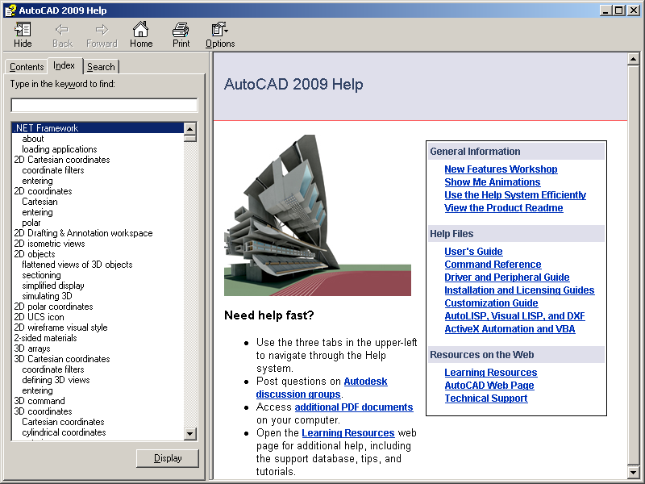
1.13 On-Line Help
Choose Help, AutoCAD Help.
or
Click the Help icon. or
Type HELP at the command prompt Command: HELP
or
Press Function Key F1

