Slide 1
Eshan College of Engineering
Department of Mechanical Engineering
AUTOCAD Basic-II
Presented by
Mr. Rajan Khare
Assistant Professor

Slide 2
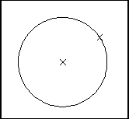
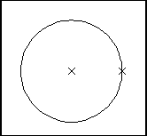
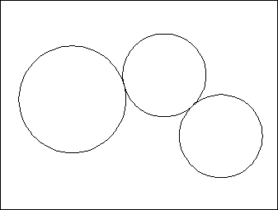
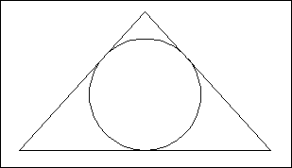
3.6 Circles
Circle Command
Circle, Center Radius
1.
Choose
Draw, Circle.
or
the Circle icon.
or
CIRCLE at the command prompt. Command: CIRCLE
One of the following options: 3P/2P/TTR/<<center point>>:
or
A center point.
A radius or diameter.
or
2.
Click
3.
Type
4.
Type
Circle, Center Diameter
5.
6.
Pick Type
7.
Pick
A radius or diameter Diameter/<<radius>>:
Circle, Tangent, Tangent Radius
TIPS:
To create circles that are the same size, press ENTER when asked for the circle radius.
When selecting a circle with a pickbox, be sure to select the circumference of the circle.
Circle, Tangent, Tangent, Tangent

Slide 3
Editing

Slide 4
AutoCAD 2D Tutorial Move Command 10.1
1. Choose
Modify, Move.
or
the Move icon.
or
MOVE at the command prompt Command: MOVE or M Objects to move
Select objects: (select) A point to move from
Base point or displacement: (pick point) A point to move to
Second point of displacement: (pick point)
2. Click
3. Type
4. Pick
5. Pick
6. Pick
Circle before move
Circle after move
TIP:
To move an object a specified distance, type a distance at the second point of displacement prompt: @1<0
- 74 -

Slide 5
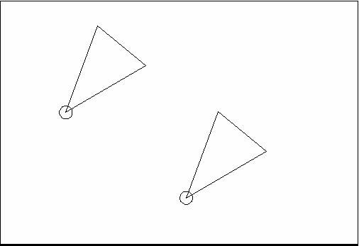
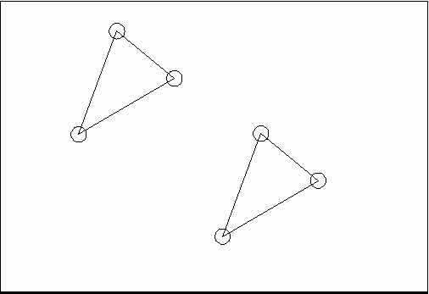
AutoCAD 2D Tutorial
Copy Command 10.2
1. Choose
Modify, Copy.
or
the Copy icon.
or
COPY at the command prompt. Command: COPY or CP
2.
Click
3.
Type
4.
Pick
Objects to copy.
Select objects: (select) A point to move from.
Base point or displacement/Multiple: (pick point). A point to copy to.
Second point of displacement: (pick point)
or
A point to copy to.
Second point of displacement: @ 1<0
5.
Pick
6.
Pick
7.
Type
Duplicate objects copied
Multiple objects copied
TIP:
To copy many objects in the same copy command, type M for Multiple at the “Base point or displacement/Multiple” option.
- 75 -

Slide 6
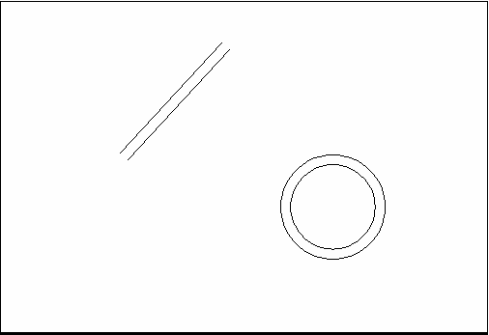
AutoCAD 2D Tutorial
Offset Command 10.4
Offset Distance
To offset a specified distance:
1. | Choose | Modify, Offset.
 |  | or
2. | Choose | the Offset icon.
 |  | or
3. | Type | OFFSET at the command prompt.
 |  | Command: OFFSET or O
4. | Type | The distance to offset.
 |  | Offset distance or <Through point>: (number)
5. | Pick | The object to offset.
 |  | Select object to offset: (select object)
6. | Pick | A side to offset object to.
 |  | Side to offset: (pick side)
7. | Pick | Another object to offset
 |  | Select object to offset: (pick side)
or
Enter to end the command.
8. Press
Offsetting objects by specifying a distance
- 77 -

Slide 7
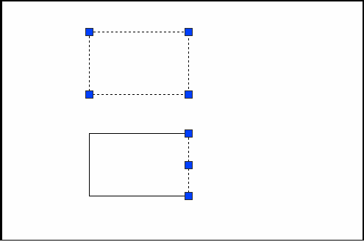
AutoCAD 2D Tutorial
Explode Command 15.4
1. Choose
Modify,Explode.
or
the Explode icon.
EXPLODE at the command prompt.
Command: EXPLODE
or
The object to explode. Select objects: (pick)
2.
3.
Pick Type
4.
Pick
Polyline before explode
Polyline (line) after explode
- 133 -

Slide 8
AutoCAD 2D Tutorial
EXTEND 10.5
1. Choose
Modify, Extend.
or
the Extend icon.
or
EXTEND at the command prompt Command: EXTEND
Select boundary edge(s)...
The BOUNDARY edge to extend to Select objects: (select)
ENTER to accept the boundary edge Select objects: (press enter)
The objects to extend
<Select object to extend> / Project / Edge / Undo: Select an object, enter an option, or press enter : (select)
ENTER when you are done choosing objects
2. Click
3. Type
4. Pick
5. Press
6. Pick
7. Press
Lines Extended to an Arc
(Arc is boundary edge)
TIP:
- Use the object selection option FENCE to choose multiple objects
- 79 -

Slide 9
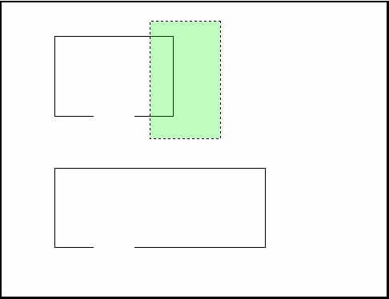
AutoCAD 2D Tutorial
Stretch 13.2
1.
Choose
Modify, Stretch. or
the Stretch icon.
STRETCHat the command prompt. Command : STRETCH Select objects to stretchby window...
C to choose CROSSING window Select objects: C
A first corner to stretch. First corner: (point)
The opposite corner to window the objects to stretch.
Other corner:(point)
2.
3.
Click Type
4.
Type
5.
6.
Pick Pick
7.
8.
Press Pick
ENTER to accept objects to stretch.
A base point to stretch from Base point: (point)

Slide 10
AutoCAD 2D Tutorial
9.
Pick
A point to stretch to Newpoint: (point) or
A distance to stretch. Newpoint: @1<0
10. Type
TIP:
The Stretchcommand must use a CROSSING windowor aCROSSING POLYGON window.

Slide 11
AutoCAD 2D Tutorial
TRIM 10.6
The TRIM command allows you to trim objects in a drawing so they end precisely at a cutting edge defined by one or more other objects in the drawing.
1. Choose
Modify, Trim.
or
the Trim icon.
TRIM at the command prompt Command: TRIM
Select cutting edge(s)...
The CUTTING edge to extend to Select objects: (select)
ENTER to accept the cutting edge Select objects: (press enter) Objects to trim
<Select object to trim> / Project / Edge / Undo: Select an object, enter an option, or press enter
ENTER when you are done choosing objects Select object to trim/Undo: (press enter)
Click
Type
4. Pick
5. Press
6. Pick
7. Press
Lines Trimmed to an Arc
(Arc is cutting edge)
TIP: Hold the SHIFT key to interactively extend instead of trim.
- 80 -

Slide 12
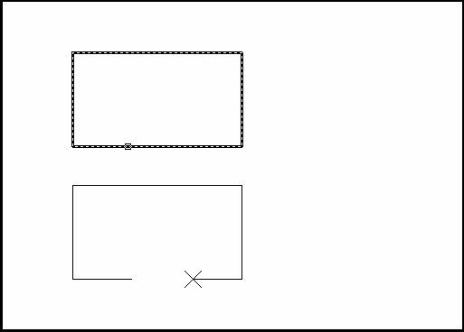
AutoCAD 2D Tutorial
Break 13.1
1.
Choose
Modify, Break. or
the Break icon.
or
BREAK at the command prompt. Command: BREAK
Object to break.
Select object: (select one object) A second break point.
Enter second point : (point)
2.
Click
3.
4.
Type Pick
5.
Pick
or
6.
Type
F to choose a different break point
Enter second point (or F for first point):(F)
- 112 -

Slide 13
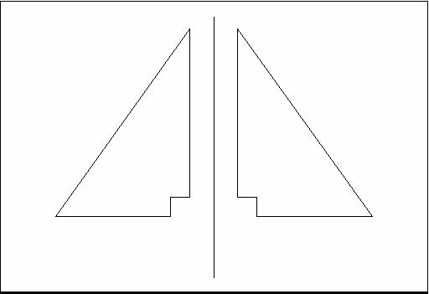
AutoCAD 2D Tutorial
MIRROR 10.7
1. | Choose | Modify, Mirror.
 |  | or
2. | Click | the Mirror icon.
 |  | or
3. | Type | MIRROR at the command prompt.
 |  | Command: MIRROR
4. | Pick | Objects to mirror.
 |  | Select objects:(select)
5. | Pick | First point of mirror line: (point)
6. | Pick | Second point: (point)
7. | Type | Yes to delete the original objects and No to keep them.
 |  | Delete old objects? Y or N
Mirror Line
- 82 -

Slide 14
AutoCAD 2D Tutorial
Stretch 13.2
1.
Choose
Modify, Stretch. or
the Stretch icon.
STRETCHat the command prompt. Command : STRETCH Select objects to stretchby window...
C to choose CROSSING window Select objects: C
A first corner to stretch. First corner: (point)
The opposite corner to window the objects to stretch.
Other corner:(point)
2.
3.
Click Type
4.
Type
5.
6.
Pick Pick
7.
8.
Press Pick
ENTER to accept objects to stretch.
A base point to stretch from Base point: (point)

Slide 15
AutoCAD 2D Tutorial
9.
Pick
A point to stretch to Newpoint: (point) or
A distance to stretch. Newpoint: @1<0
10. Type
TIP:
The Stretchcommand must use a CROSSING windowor aCROSSING POLYGON window.

Slide 16
AutoCAD 2D Tutorial
TRIM 10.6
The TRIM command allows you to trim objects in a drawing so they end precisely at a cutting edge defined by one or more other objects in the drawing.
1. Choose
Modify, Trim.
or
the Trim icon.
TRIM at the command prompt Command: TRIM
Select cutting edge(s)...
The CUTTING edge to extend to Select objects: (select)
ENTER to accept the cutting edge Select objects: (press enter) Objects to trim
<Select object to trim> / Project / Edge / Undo: Select an object, enter an option, or press enter
ENTER when you are done choosing objects Select object to trim/Undo: (press enter)
Click
Type
4. Pick
5. Press
6. Pick
7. Press
Lines Trimmed to an Arc
(Arc is cutting edge)
TIP: Hold the SHIFT key to interactively extend instead of trim.
- 80 -

Slide 17
AutoCAD 2D Tutorial
Break 13.1
1.
Choose
Modify, Break. or
the Break icon.
or
BREAK at the command prompt. Command: BREAK
Object to break.
Select object: (select one object) A second break point.
Enter second point : (point)
2.
Click
3.
4.
Type Pick
5.
Pick
or
6.
Type
F to choose a different break point
Enter second point (or F for first point):(F)
- 112 -

Slide 18
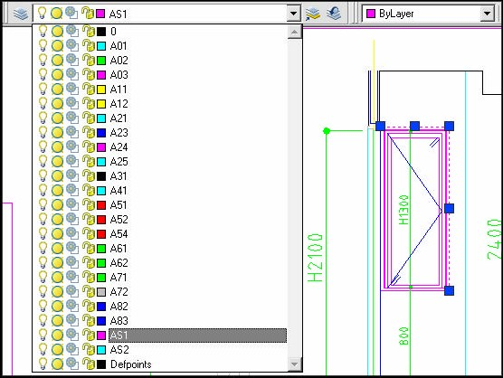
AutoCAD 2D Tutorial
Layer Shortcuts 12.3
Changing the Layer of an Object
Click
Select
Once on the object to change.
the desired layer from the Layer Control Box dropdown.
AutoCAD will move the object to the new layer.
Select layer
Select object first

